Slide 1

Underwater Dreams
Notes:
This report is on the documentary ‘Underwater Dreams’, about a team of underdog high school students from a poor high school that defeated MIT in an underwater robotics competition. Presented by: Ethan Gray, John Leahy, Aidan Ritter and Aidan Sharpe.

Slide 2
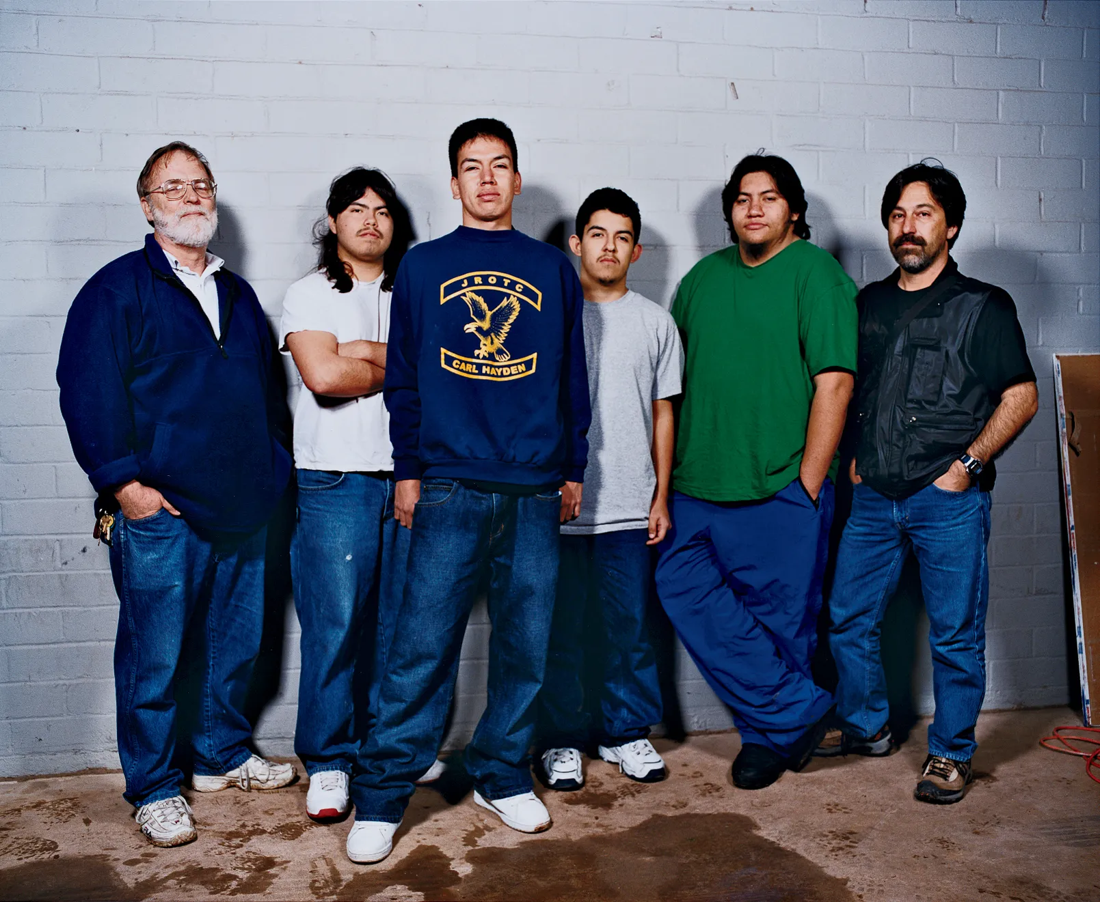
Movie Overview
Introduce Team/Teachers
Overview of competition and trials
Teams get some information (what tests are done in the first portion of the competition), but nothing else
Use own resources and knowledge to build robot
Part 1: Robot Performance
Part 2: Presentation
Part 3: Written Report
Left to Right: Dr. Allan Cameron, Lorenzo Santillan, Oscar Vasquez, Cristian Arcega, Luis Aranda, and Fredi Lajvardi
Notes:
The movie “Underwater Dreams” is a documentary about a group of high school students in Carl Hayden Community High School in Phoenix, Arizona who entered a collegiate level robotics competition and won. The team, pictured above, consisted of [list names]. The Carl Hayden Team only had the minimum funding the school could provide them and the requirements the robot should have which were previously sent by the judges. The competition consisted of three parts; the actual performance of the robot, the oral presentation to the judges about the design, and the written report.

Slide 3
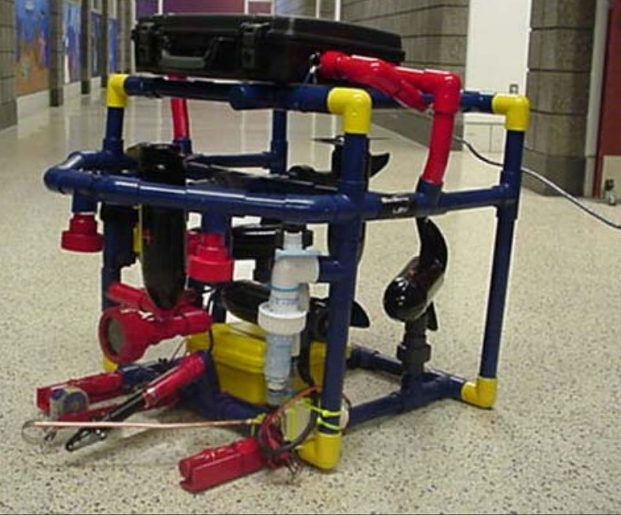
How Carl Hayden Won
Well-developed design (not without issues)
Multi-functional
Operated with necessary precision
Ingenuity to solve issues
Use of tampons to prevent flooding
Time and Effort in presentations
Notes:
Carl Hayden’s robot, named Stinky, was created from materials found around the robotics lab and bought from a local Home Depot. The likelihood of the Carl Hayden team winning was very small, but they managed to do it. They ended the first part of the competition in fourth place, which shows that their robot was still well produced. One of the challenges involved removing a sample of a liquid from a container underwater, which was one of the hardest tests done considering how many of the teams did not even attempt it, but Carl Hayden managed to do it with ease. Each team member studied their hardest and made sure Stinky could be the best it could be. They did run into problems during building, but they met them with the creativity required to solve them. In order to fix a leaking problem they constantly faced, they bought tampons and put them around the areas where flooding occurred the most. What put Carl Hayden above all the other teams, however, was their presentation and written report. Where most teams disregarded them and left them to the end, the Carl Hayden teams made sure adequate time and effort was put into these reports, as they were just as important as the robot itself.

Slide 4
Where are They Now?
Notes:
The Carl Hayden High School robotics team pulled off something that nobody, including themselves, thought that they could do in beating MIT. It’s been 18 years since they pulled off this amazing feat for there school. Many of the members of the team went their separate ways and have lived very different lives. Even though some of them may not have the best careers, they will never forget the impact they had on their school and the impact that there success will continue to have on the kids that attend their alma mater. So let’s see what the team members of the Carl Hayden High School robotics team are at this point on their lives.

Slide 5
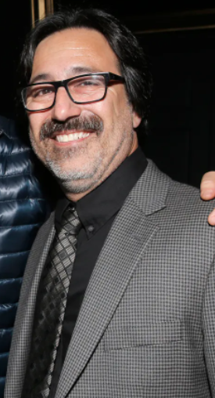
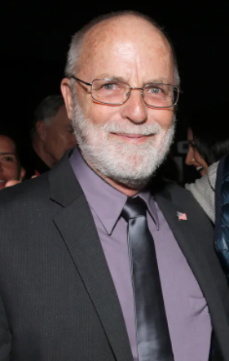
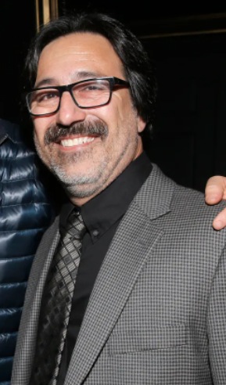
Dr. Cameron
Fredi
Retired
Teacher
Notes:
Dr. Allan Cameron, after his many years of teaching at Carl Hayden high school, retired from teaching. He does, however, voluntarily assist and mentor the school’s robotics team. He was an intricate part of the team and a huge factor in their success. His relationship with Fredi and the high school has helped him continue to help the future students and the robotics team and I’m sure he will continue to help them for years to come. After the teams success in 2004, Fredi has continued to work at Carl Hayden High School and has continues to be the main teacher in charge of the robotics team. Fredi has had such an impact on the school and the students on the robotics team that the students and faculty will always remember what himself and Dr. Cameron did for the school.

Slide 6
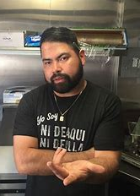
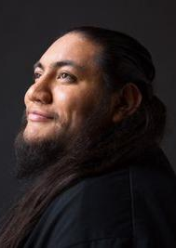
Lorenzo and Luis
Notes:
Lorenzo went on to start a catering business with Luis, and has now taken that business as his full time job. This business is called Ni De Aqui Ni De Alla (Which means ‘neither from here nor from there’ in english) He serves tacos and other mexican-inspired foods.
As mentioned before, Luis had started the catering business with Lorenzo, however he was not as on board with the business as Lorenzo was. He still helps with the catering business, but mostly works as a full-time garbage man.

Slide 7
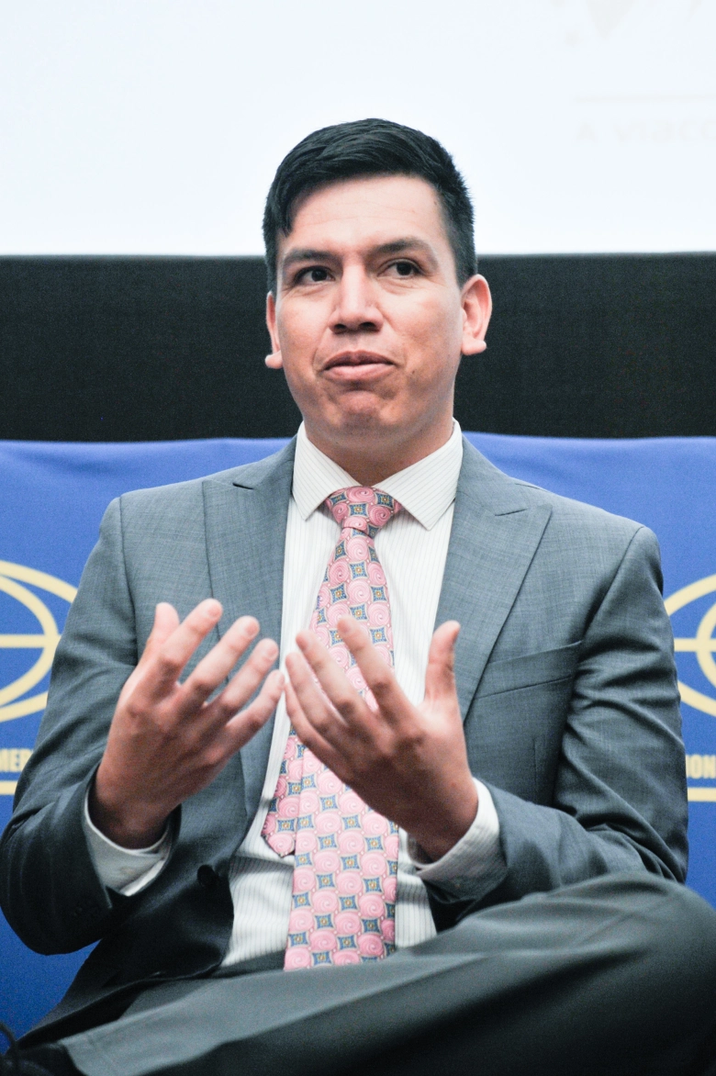
Oscar
Engineer
Notes:
Oscar has been all over the place over the years. He wanted to join the military, however he couldn’t enlist because he was technically an illegal immigrant. However, this did not stop him. He deported himself, leaving his wife and kids, and went back to mexico where he would wait for years to be accepted as a legal immigrant to the United States. Sure enough, he was eventually accepted and went on to serve for two tours in Afghanistan. Now he is an engineer in Montana and is a Latino advocate.

Slide 8
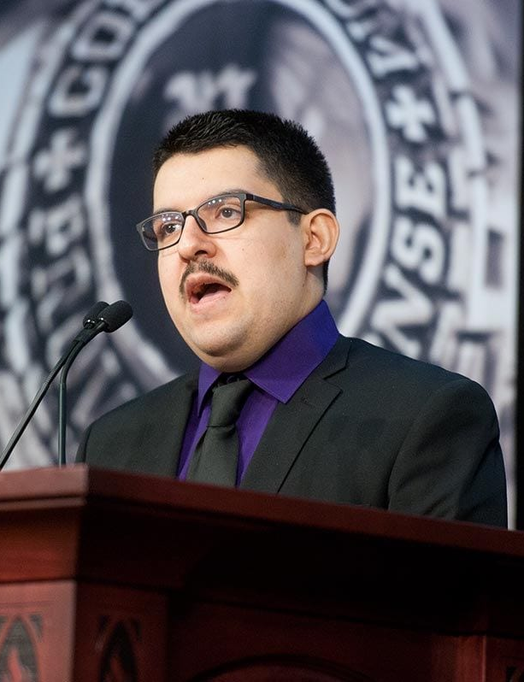
Cristian
Home Depot Employee
Notes:
Cristian had dreams of going to college, and it looked like he was going to have the funds to be able to do so with his presidential scholarship, however that was revoked due to the Prop 300. He now works at Home Depot and is working towards being able to afford to go back to school as fast as possible.

Slide 9
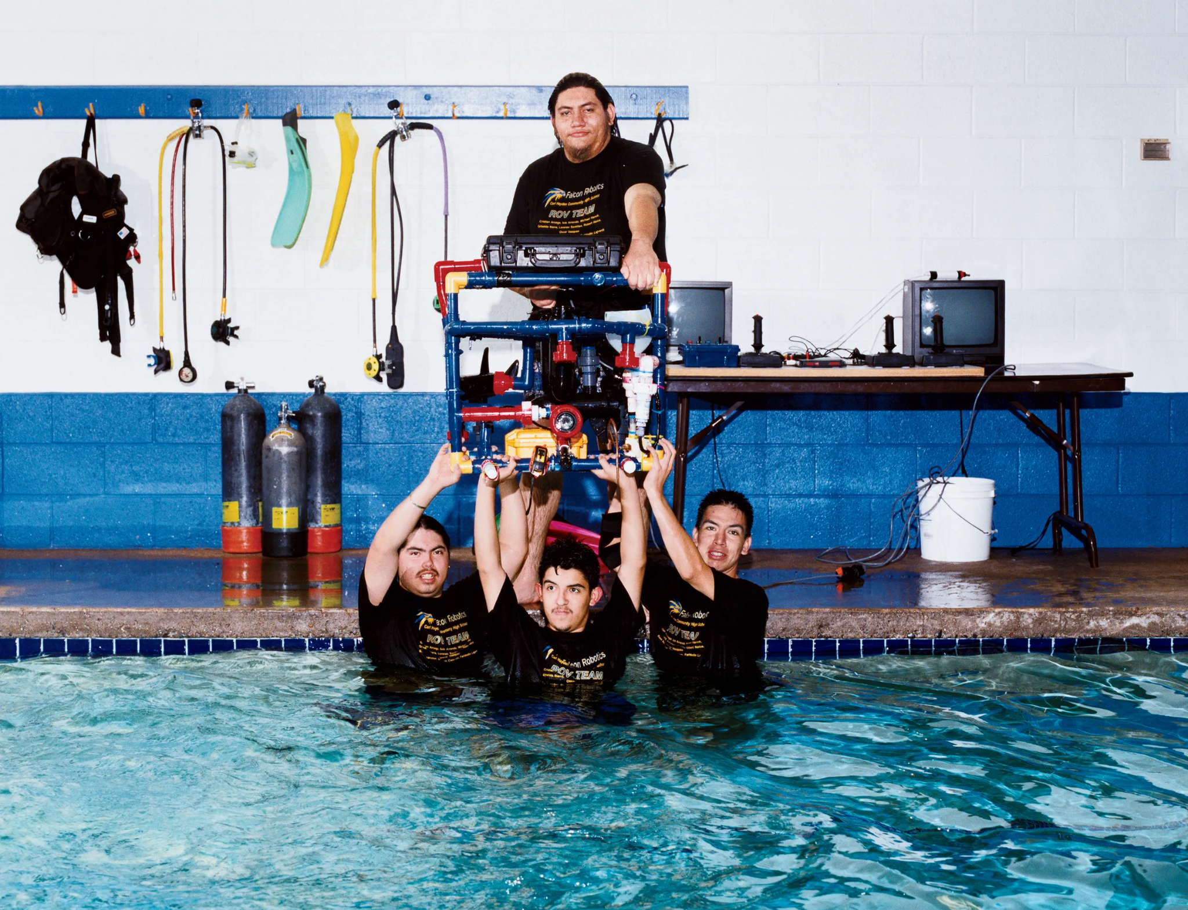
Engineering Issues
The Troubleshooting Process
Test runs in pool before competition
Dealing with limited resources
Carl Hayden’s low funding (Ethical Issues)
Implementing Creative Ideas
Use of Tampons
Effort and Professionality
Carl Hayden won from their paper and presentation
Notes:
Despite being high school students, the team was faced with numerous challenges that all engineers have to overcome. Design issues will always occur, and during initial testing phases it is almost impossible to find the perfect solution, so when the Carl Hayden team began running their robot in the pool they had to identify the weak points of their robot and figure out how to fix them. Finding flaws early on in the design process is one of the best ways to ensure the project is going in the right direction. The Carl Hayden team was also at a disadvantage when it came to funding when compared to their competitors, due to the difference in high school and college development along with being in an underprivileged area, so they had to make due with the resources they had. They used PVC pipes, wood bought at Home Depot, and scraps lying around the robotics area to build one of the best working robots at the competition. Each difficulty that the team faced was met with a solution that fixed it, which required some creative thinking. The tampon idea was just one way that they managed to build their robot to handle each task required of it. What truly gave Carl Hayden the win, however, was the last two parts of the competition: the presentation and the report, which the team handled more eloquently and more professionally than most of the teams there. The team knew their robot inside and out, and they completely

Slide 10
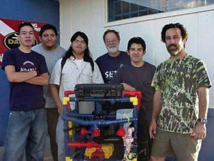
Engineering in High School
Introducing Engineering at a young age
Robotics Club: Mechanical + Electrical and Computer Engineering
Proper Equipment and Funding
High School vs. College
Materials, experience, level of knowledge
Notes:
Carl Hayden high school is a great example of why introducing engineering in high school is a good idea. They did this through robotics, which incorporates mechanical, electrical and computer engineering into an interactive project. Although the high school did not have the proper equipment, materials nor funding like MIT would have, they still made due with what they had and were able to come out on top due to their creativity and their drive to do the best that they could. Introducing engineering in high school is very beneficial to not just the students, but also to the field itself because those who get involved in engineering at younger ages have such creative ideas and don’t stick to what they are taught, they just need to learn how they can make their ideas a reality.

Slide 11
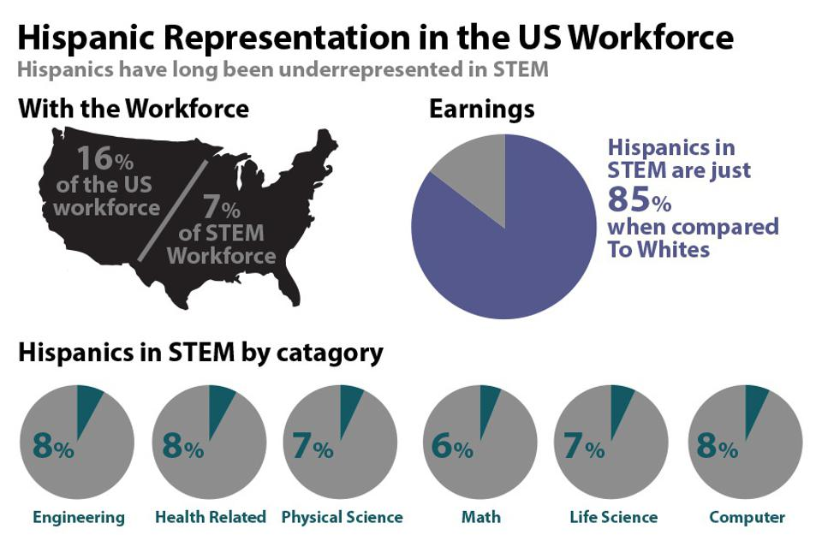
Social Issues
Hispanic representation in STEM
Carl Hayden were the only hispanic people there
“Pipeline” of keeping kids in STEM
Only two of the original team stayed in STEM fields
End of Movie - Protests and Deportation
Documentation
Notes:
This documentary shed light on numerous social issues, such as hispanic representation in STEM, the lack of kids who stay in STEM and the controversy of deportation. The lack of hispanics in STEM was made clear by the fact that the Carl Hayden high school team were the only hispanic team at the competition. And with that in mind, out of those kids only 2 went on to continue their journey in the STEM field. There needs to be something to be put into place to guide more kids to stay in STEM fields to prevent someone like Cristian who had to leave STEM because he could not afford to stay. And as far as Oscar goes, he had to fight for his place in the STEM field in a way that not many people would have the braveness to do, which is turning himself into the police and deporting himself. It is sad that it has to come to that just so someone can move on with their life.

Slide 12
References
https://www.wired.com/2014/12/4-mexican-immigrant-kids-cheap-robot-beat-mit/
Carl Hayden’s Final Report

Slide 13
References (Pictures)
Teenagers Win a Robotics Contest in ‘Underwater Dreams’ - The New York Times (nytimes.com)
https://www.azcentral.com/story/life/az-narratives/2014/07/17/phoenix-high-school-win-mit-resonates-decade-later/12777467/
Underwater Dreams (kuer.org)
How 4 Mexican Immigrant Kids and Their Cheap Robot Beat MIT | WIRED
Building robots and dreams at a high school in Arizona - YouTube

